Slide 1
Team GRIPE
Marc Kleefstra
Earle Cottingham
Patrick Barnes

Slide 2
GRIPE
Greenwood Bank Incident Protocol Enforcement

Slide 3
What Do We Have a GRIPE Over?
Tech support
Employees lined up at the IT help desk guy’s office
Repeat problems and no organization
Keeping track of said tech
IT guys have no idea what PC you broke
The suits have no idea who stole what laptop
Where is my stapler?
No existing system for any of this

Slide 4
A New Way to Handle Things
GRIPE
Tracking system for technology assets for Greenwell Bank
Ticket system to organize and regulate tech support

Slide 5
Tell Me More!
GRIPE will be a web-based application
Never lose track of who has what PC or printer
What was the serial for Office 2013 again?
Make your tech support problems heard!
Stay up to date on why that floppy disk won’t fit into your CD drive!
The boss sees and knows all

Slide 6
The Basics
Ticket tracking system
IT guys have a GRIPE with your tickets
Feedback on ticket progress
Keep track of ALL the things!
Who has what
What department has what

Slide 7
Personas
General employee
Log in and create tickets
View his or her own tickets and their progress
See what equipment they’re responsible for

Slide 8
Personas
IT Help Desk
See all available tickets
Assign tickets to themselves
See what equipment belongs to ticket creator
Add comments and updates to tickets
Close or release tickets back to the pool

Slide 9
Personas
Executive
Read-only access to all tickets
See all the assets and who it all belongs to

Slide 10
Personas
System Admin
Remove tickets from system
Update, remove, add assets and to whom they belong
Keep track of error logs with GRIPE
Everything

Slide 11
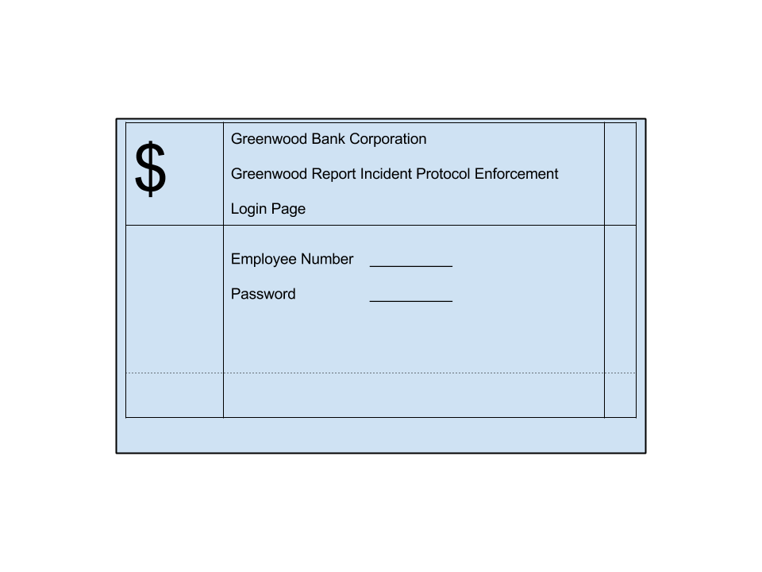
What Else?
Security
Login access on-site only
Error handling
No need to spam errors to end users
Log it all for the system admin

Slide 12
User Case
Timid Tom, staff support, can’t read documents from elsewhere in the office
Tom logs into GRIPE and submits a ticket
Help Desk Harvey sees the ticket and takes it
As Harvey works on the ticket, he leaves update notes
Harvey assigns Tom a new PC to fix the problem
Harvey closes the ticket
Sly Admin Slim makes a note to update Tom’s asset listing to show the new PC

Slide 13
Team GRIPE
Patrick Barnes
Project Manager
Programmer
User Experience
Marc Kleefstra
Master Programmer
Database Admin
Design
Earle Cottingham
Programmer
Testing
Documentation

